Slide 1
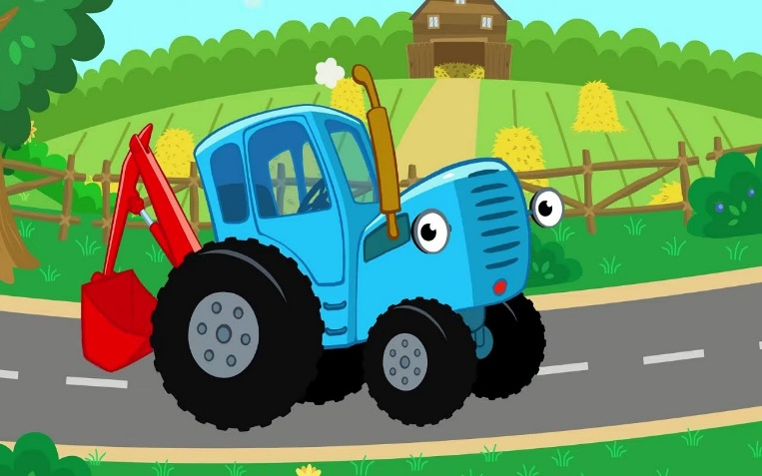

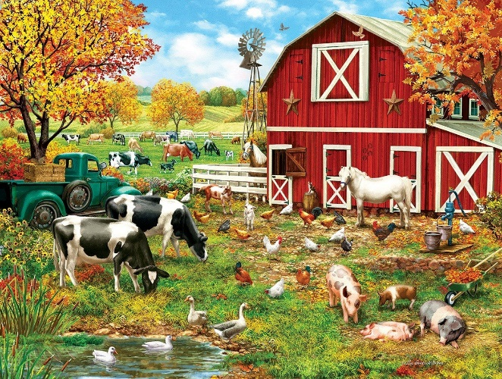
Information security improvement plan for the household
Denys Shabelnyk ViA-KI-2022

Slide 2

Table of contents
1. Main roles and staff responsibilities;
2. Risk assessment (both users and technology);
3. Description and justification of improvement measures;
4. Priorities of measures;
5. Maintenance progress.

Slide 3
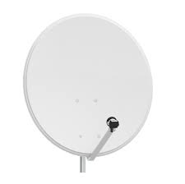
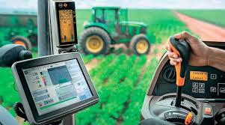

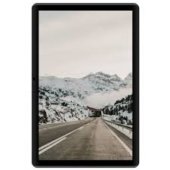
Environment
A common household has IT devices and networks below:
Laptops
Mobile devices
Beacons and communication satellite receivers
Digital equipments on agricultural machinery

Slide 4
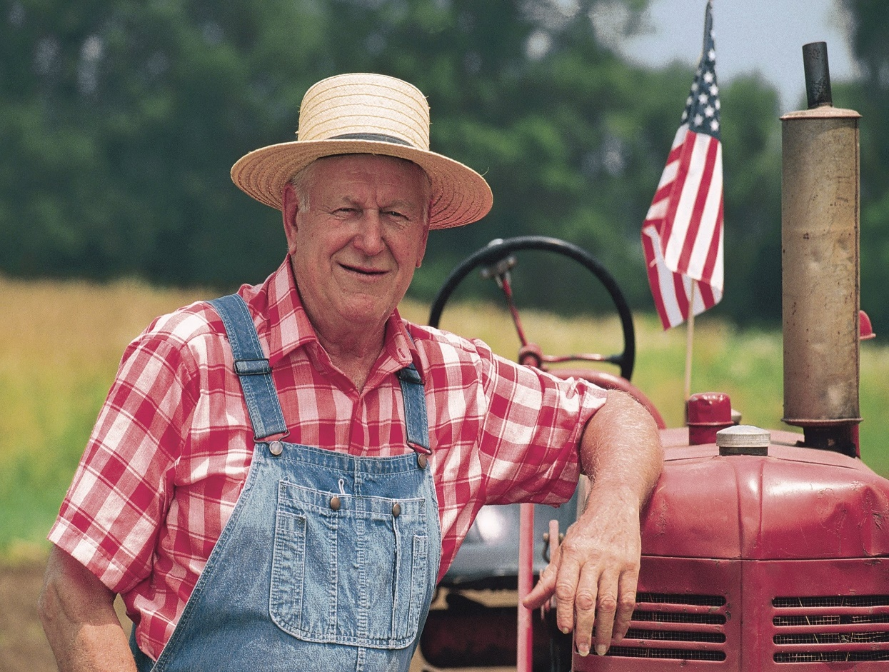
Main roles and staff responsibilities. Owner/Founder
Manage a small household and its staff;
Conduct negotiations with sellers and buyers;
Create strategy what cultures should grow up annually;
Create budget and analyze all household finance.

Slide 5
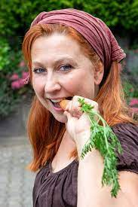
Main roles and staff responsibilities. First deputy
Owner’s wife as usually
Responsibilities:
Take cares about staff(food,uniform, insurance,etc);
Take cares about scientific achievement implementation;
Take cares about all staff and its responsibility in general;
Can present household owner on conferences and special meetings.

Slide 6

Main roles and staff responsibilities. Family helpers
Owner’s children. Heirs
Responsibilities:
Help other staff with its daily work;
Take cares about agricultural machinery;
Take cares about communication between staff and household owner;
Keep learning about farming.

Slide 7
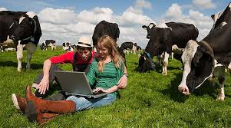
Main roles and staff responsibilities. Hired staff
Take cares about area which staff working with;
Share information about issue of harvest with heirs in case it happened immediately;
Paying attention to the prices of products in the markets;
Follow by manual in case using scientific achievement in work.

Slide 8




Household staff hierarchy
Higher management
Deputy
Hired staff

Slide 9
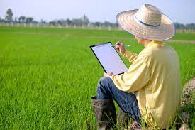
Risk assessment Owner.
Low technology usage. Paper work is more practical in daily work;
Frequently issues with Internet connection or problem with electricity;
Lose important information in case natural disasters

Slide 10
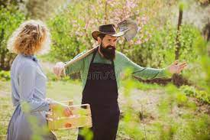
Risk assessment First deputy.
Storehouse with food, uniforms, goods could be broken by natural disasters;
Scientific achievements could be lost in case wrong temperature storage;
Responsible employee may not come to work due to illness. It’s deputies should doing first deputy or deputy staff.

Slide 11
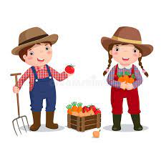
Risk assessment Deputy staff.
They can’t help other staff due illness or don’t have possibility because they are at school;
They can’t fix agricultural machinery in case they needed serious repair;

Slide 12
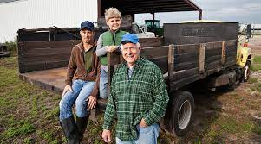
Risk assessment Hired staff.
Do not have ability take cares about two areas at one period of time;
Do not have ability working extra time at harvest time because it’s restricted by legislation;
Can’t follow by manuals if they do not know foreign language;

Slide 13
Owner
Description and justification of improvement measures
To improve and development its business, the household owner should define and minimize risks. First of all, it should try to use technology in its business. Use satellite connection, cloud technology and mobile devices. Also, the household owner must defeat its electricity and buy a small generator for keep any digital information in case electricity will be lost.
Priority of measures Creating of satellite connection must have the first priority. Buy laptops and mobile devices should follow after and make a subscription with Cloud storage is a third priority. All business reports should be stored in a cloud.
Maintenance progress
Training deputy staff to support satellite dishes and wired communications. Check out payment periods of bills and take cares about tariffs and bonus programs.

Slide 14
First deputy
Description and justification of improvement measures
To improve your knowledge and skills, first deputy should keep learning about human resources, psychology and should be ready one day takes responsibility about all household. Also, she have to keep focus on scientific news about farming.
Priority of measures
First of all first deputy should buy annual subscription of farmer magazines, psychology articles. Also, she have to attend farming conferences if it possible and she should has a good relathionship with their neighborhoods.
Maintenance progress
If a first deputy wants to be a successful manager, she needs to keep learning and implements it’s knowledge day-by-day in her work. Also, she have to share knowledge with other farmers – it is a key to keep friendly atmosphere around household.

Slide 15
Deputy staff
Description and justification of improvement measures
Young generation should keep learning and keep calm with their responsibilities every day. Improve their knowledge in machinery and keep whishes to protect and improve family business.
Priority of measures
As a pupil, deputy staff should attend a school and do not missed lessons. Take part in school sport events, because it’s improve their heath and try to improve your skills with agriculture machinery.
Maintenance progress
Keep learning, not to be afraid trying to implement new knowledge and be open-minded with other staff.

Slide 16
Hired staff
Description and justification of improvement measures
Hired staff should doing its job with high quality and high level of responsible. If an employee doesn’t know how grows beans or wheat it must has ability to looking for information on the Internet, special magazines or manuals. Of course, any staff must know English language if a household use seeds and fertilizer from abroad.
Priority of measures
Staff training, language courses, improve staff skills with digital technologies.
Maintenance progress
Cross-check after each other, help each other on complicated situations and do not be afraid to experiment with new technologies in their areas of responsibility.

Slide 17
Cybersecurity risk assessment in general
No access to the cloud account where might be stored all accounting. All hired staff might be without salary if account won’t be recovered.
Problems with state regulations if financial reports will be sent after deadline because there were no Internet connection or satellite network did not work.
Some digital devices might be broken because they fell down or broken down after bad weather
Some agricultural machinery might be inactive because some license keys or security passwords have lost or forgotten by owner side.

Slide 18
Conclusions in Cybersecurity aspect.
All security keys and password should be stored only in owner in a safe. Access to the safe should also has the first deputy only.
The owner must has second internet connection(can be not static) for sending important financial reports in time.
All digital devices which should use hired and deputy staff should use with covers to protect them from bad weather or fell down issues.
All digital keys and security password for agricultural machinery should be updated in time and with authorized suppliers and store also in the safe.

Slide 19
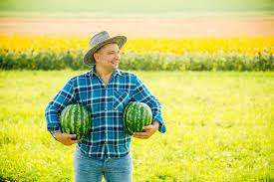
Thank you for your attention!

